Slide 1
Dance Injury Analysis
Christine Gurek and Heidi Beardsley

Slide 2
Research Question
At what age are dancers most vulnerable to injury?
When should injury prevention education begin for dancers?
Can we use age to predict sprain and/or fracture injuries?
What is the most common ways dancers are being injured?
Notes:
Heidi
Our project aims to explore the question: At what age are dancers most vulnerable to injury?
This is an essential question because understanding when dancers face the highest risk can guide targeted prevention efforts and improve dancer longevity.
And to dive deeper, we’ve outlined three sub-questions:
First, When should injury prevention education begin for dancers?
By pinpointing the age of vulnerability, we can determine the optimal time to start educating dancers about injury prevention strategies, helping them build resilience early in their careers, as a dancers career is already short.
Second, Can we use age to predict sprain and/or fracture injuries?
We aim to explore whether age serves as a reliable predictor for specific types of injuries, such as sprains or fractures, as these we found these to be the most common types of injuries. This analysis could lead to personalized injury prevention plans.
Third, What are the most common ways dancers are being injured?
By identifying common types of injuries, we can provide actionable recommendations to reduce these risks, ensuring dancers stay healthy.

Slide 3
DATA
NEISS Database
Submitted a query for dance-related injuries
The query returned an Excel sheet with the requested data, any Dance related injuries from the past 10 years
It also provided an excel sheet containing a key for the textual data that they had made into numerical data
We downloaded a total of 11 excel sheets: the patient reports by year and the key data file
Notes:
c

Slide 4
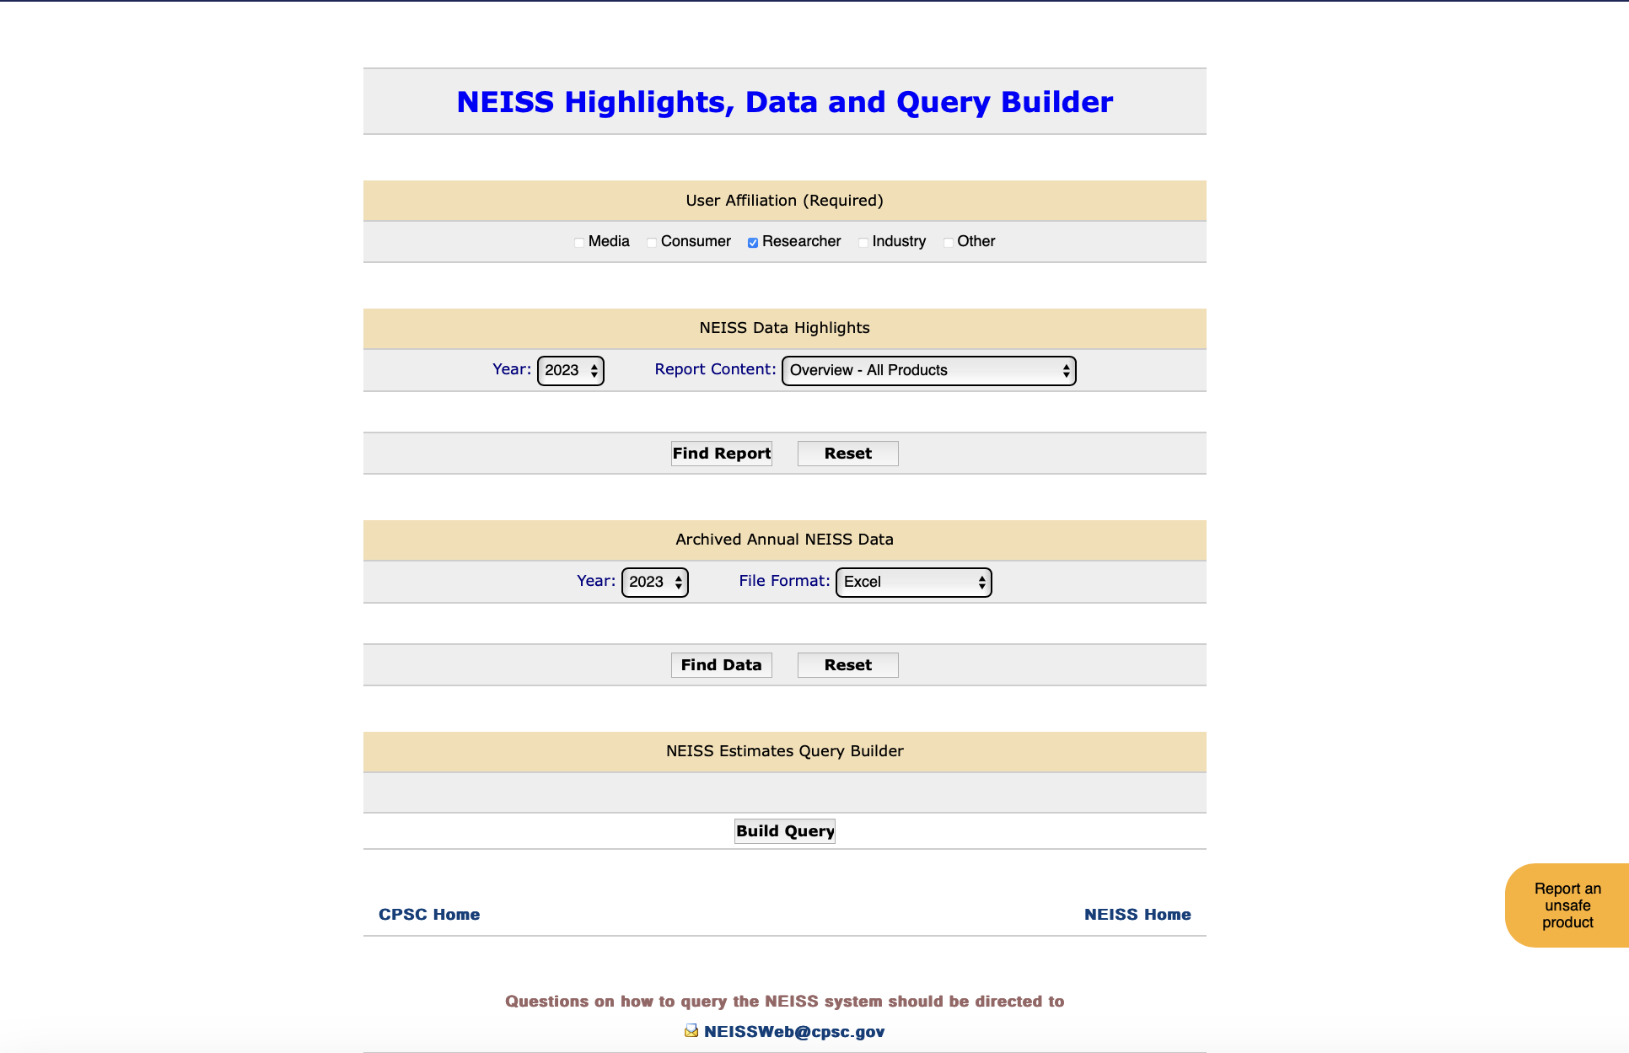
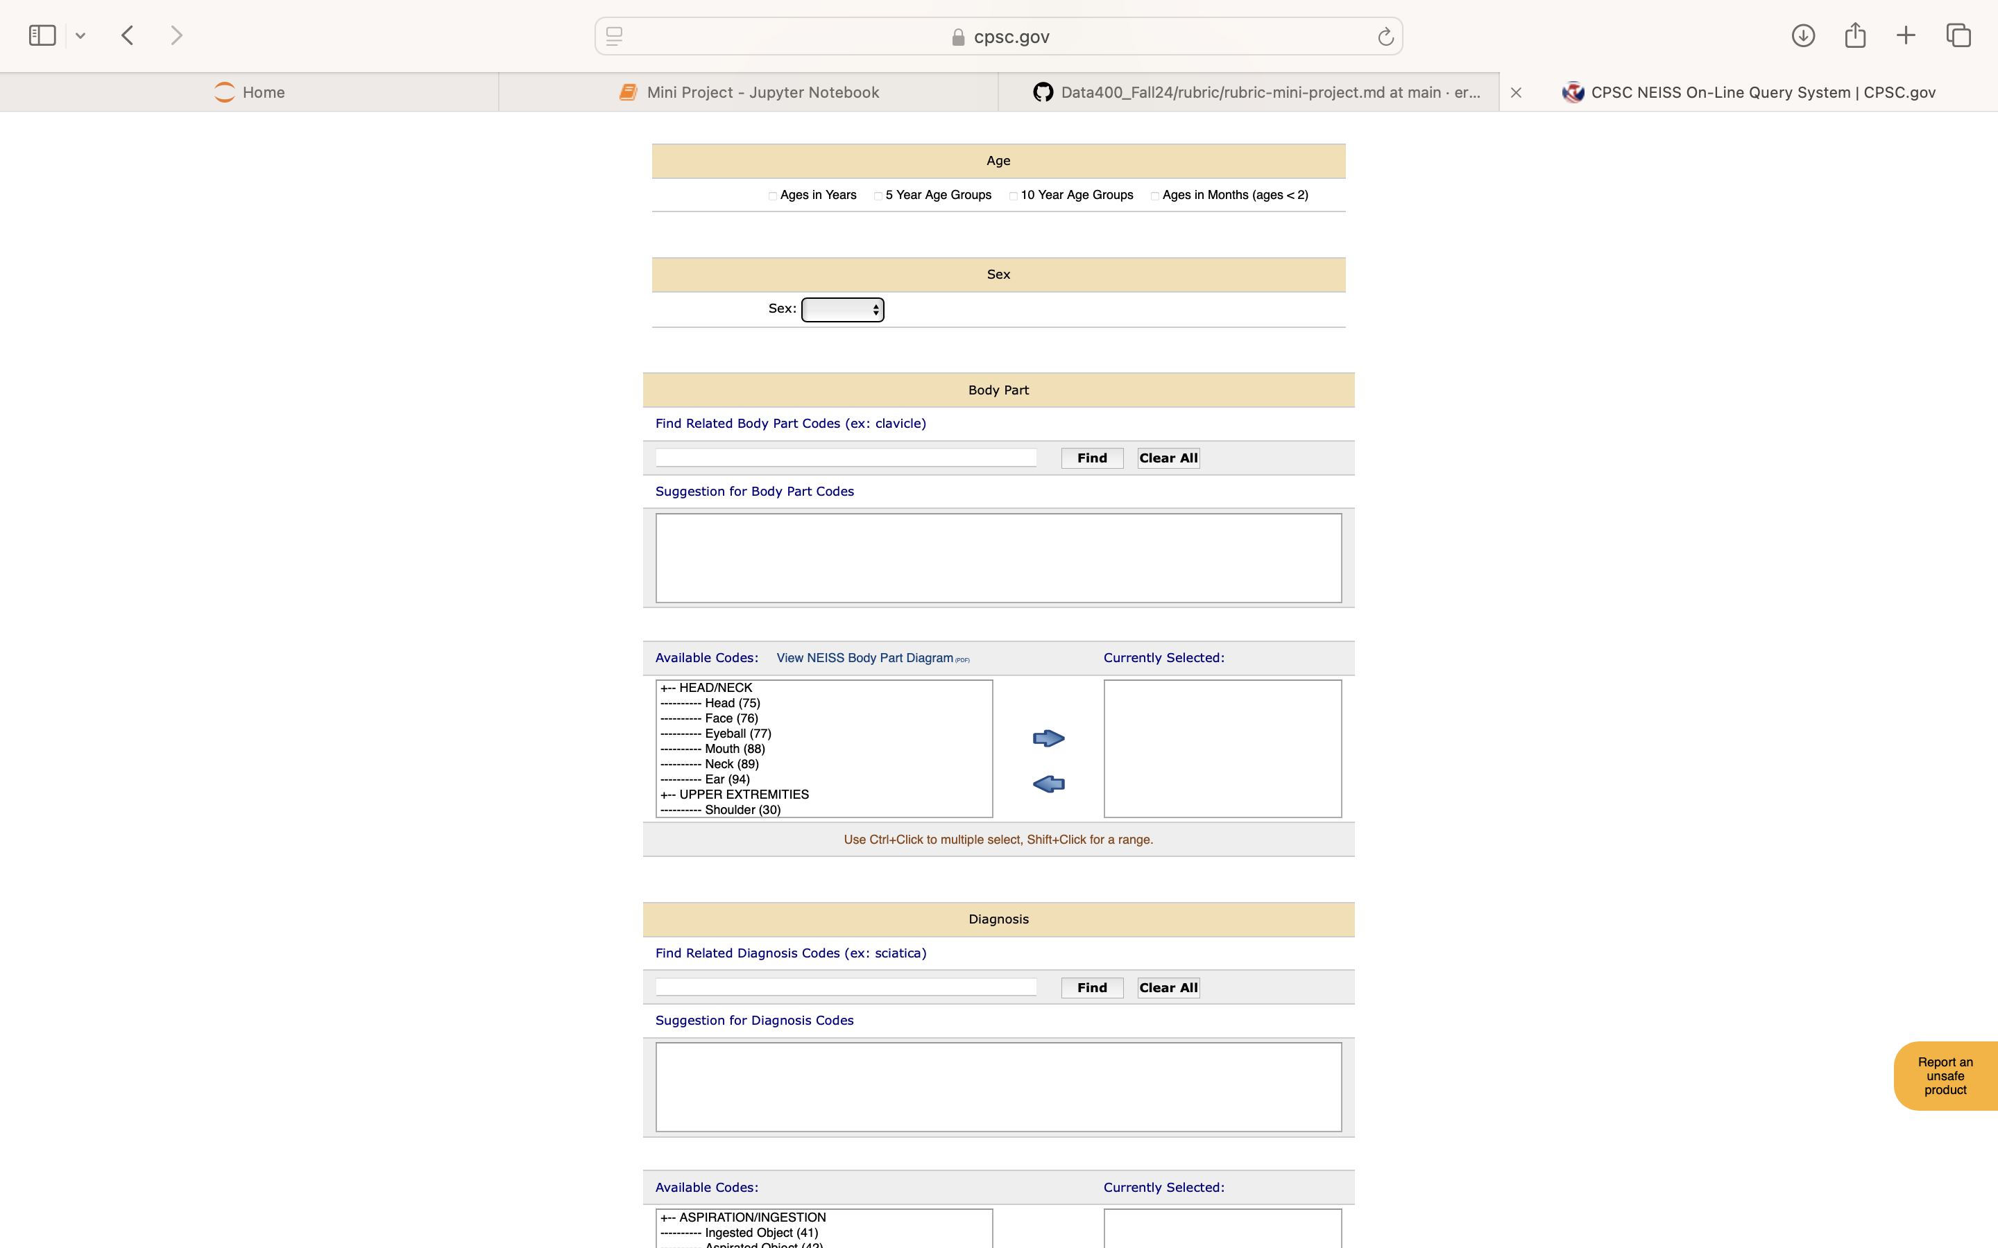

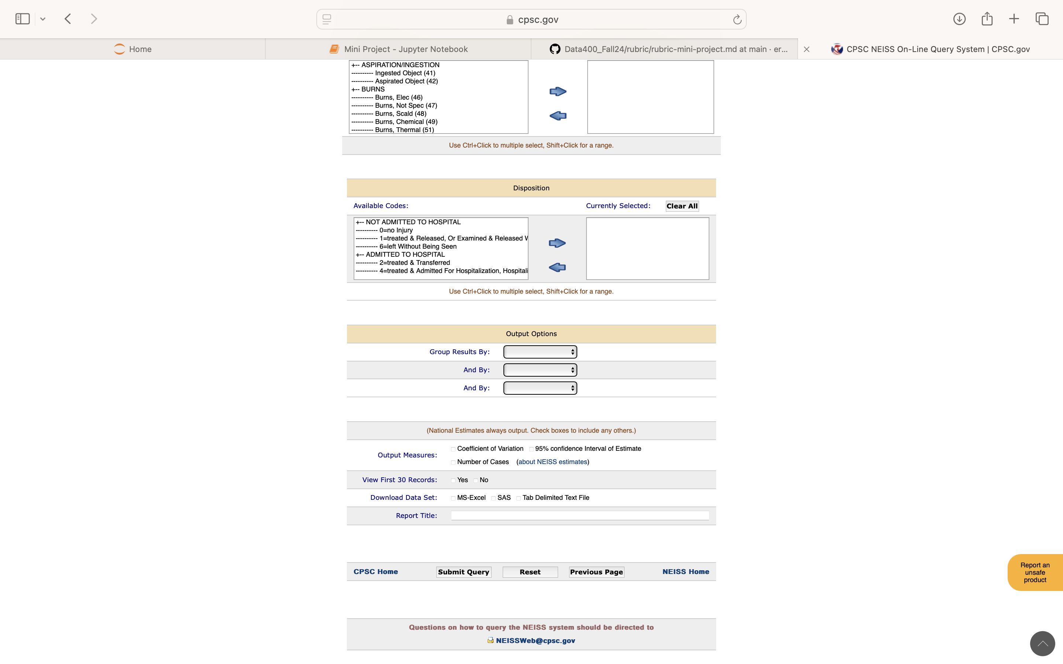
Notes:
c

Slide 5
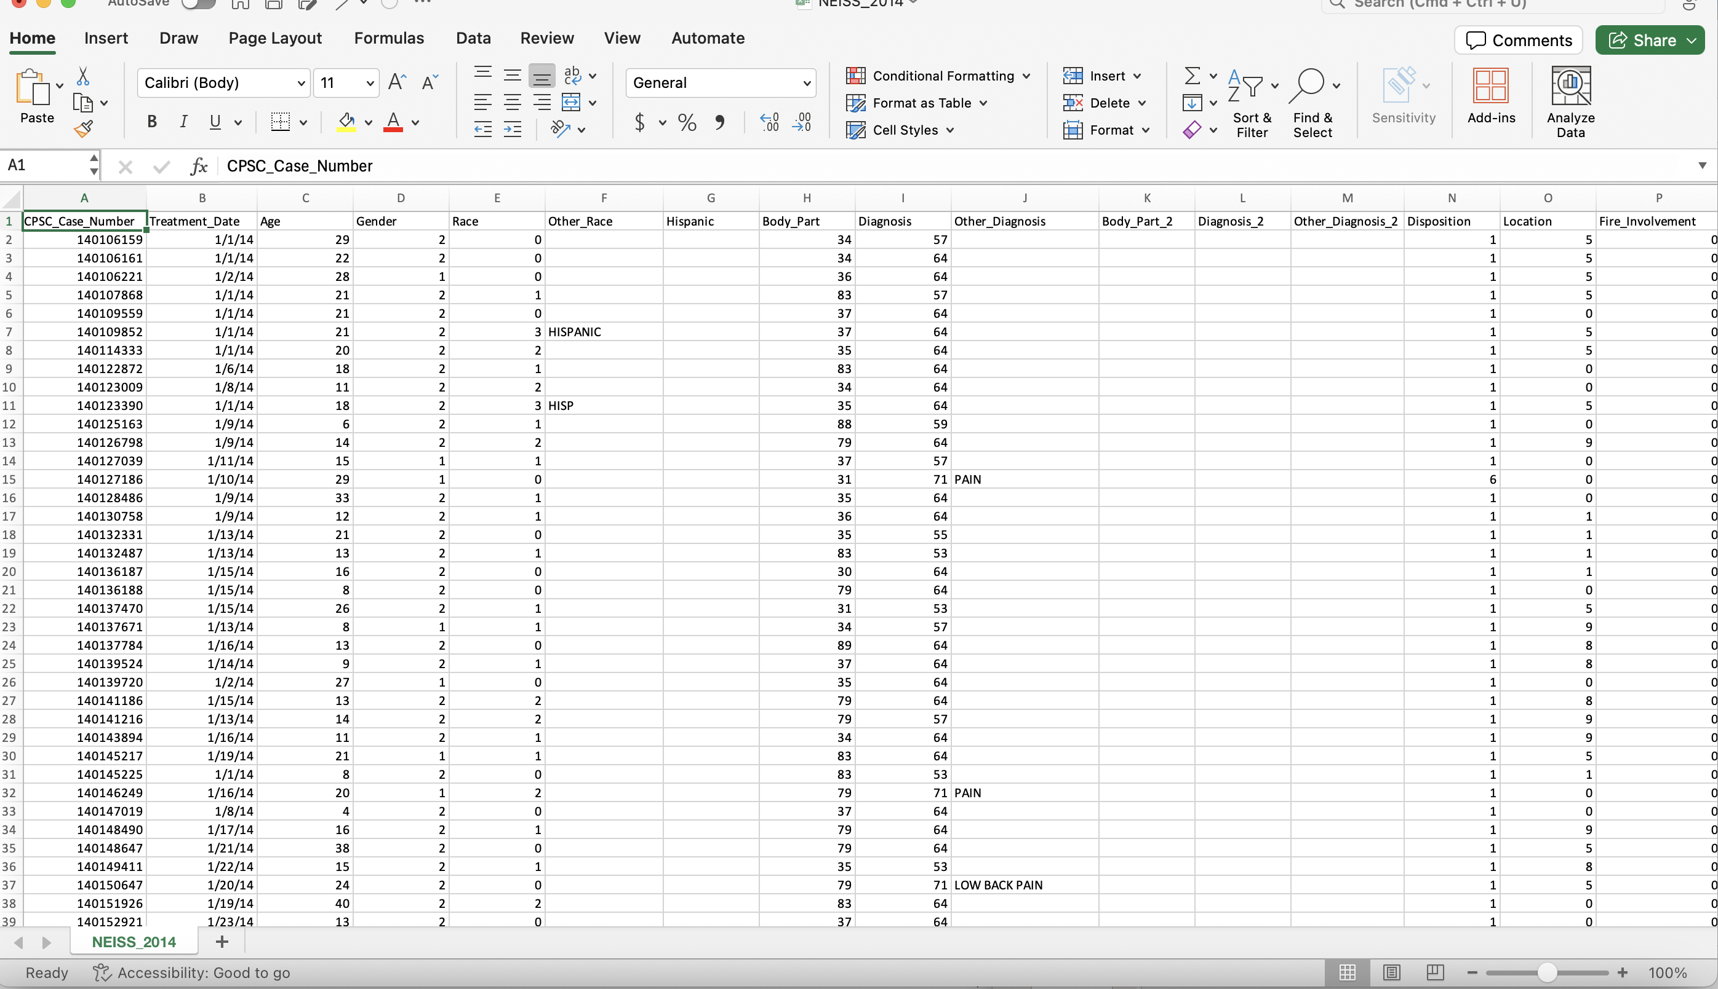
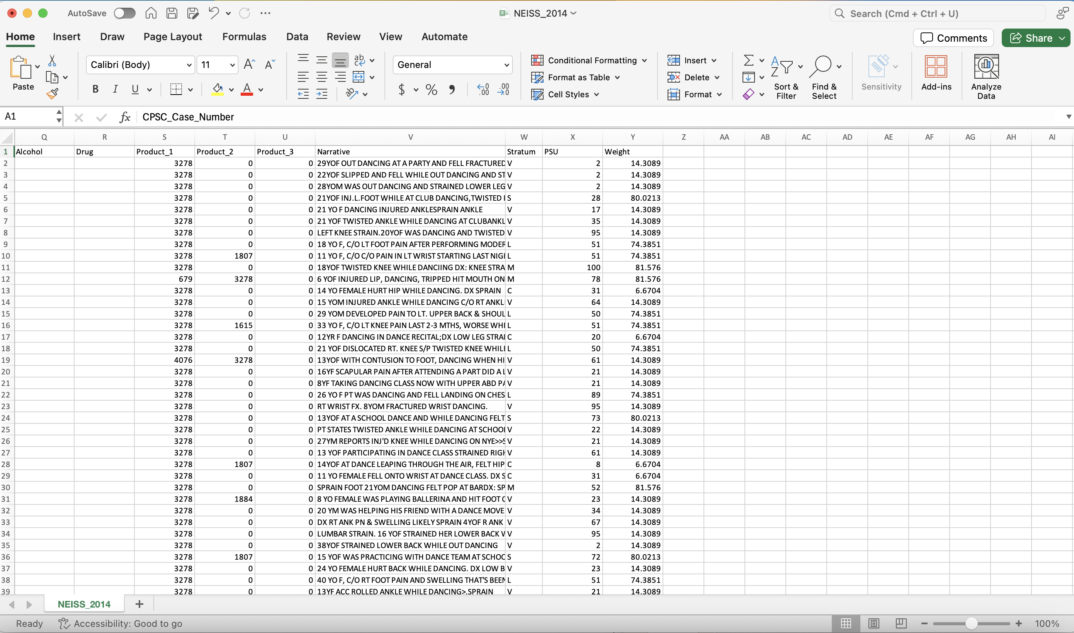
Notes:
c

Slide 6
Data Cleaning Process
Made copies of the excel sheets so I would still have the original files
Filtered the data in excel to only include cells that included the words "Dance Class" in the narrative column, so that it was more likely the patient was a long term dancer
Removed any unnecessary columns
Converted the excel files to csv files to import them into my Jupyter Notebook
In Jupyter Notebook, we concatenated all of the files together so they were all in one data frame
Notes:
c

Slide 7
Cleaned Data
After originally having 25 columns, there are now 6:
CPSC_Case_Number
Treatment_Date
Age
Body_Part
Diagnosis
Narrative
After filtering out many of the non-dancers, there are 4911 rows
Notes:
c

Slide 8
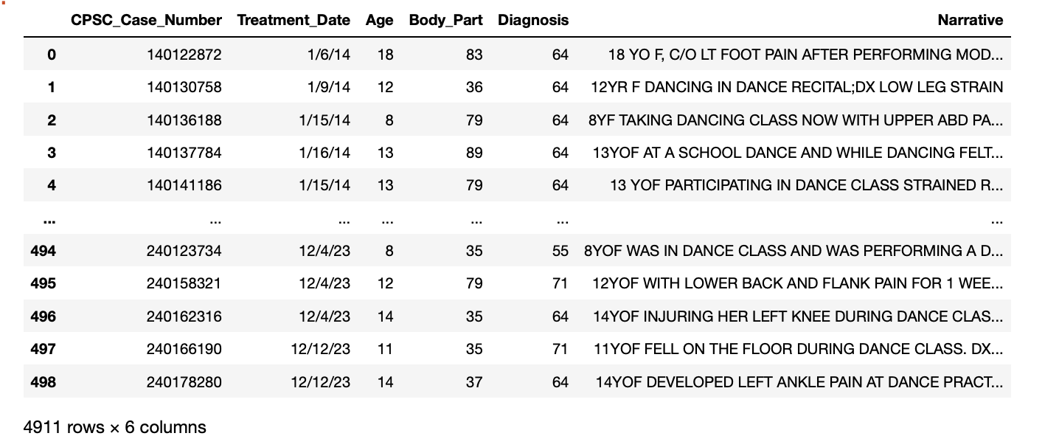
Cleaned Data
Notes:
c

Slide 9
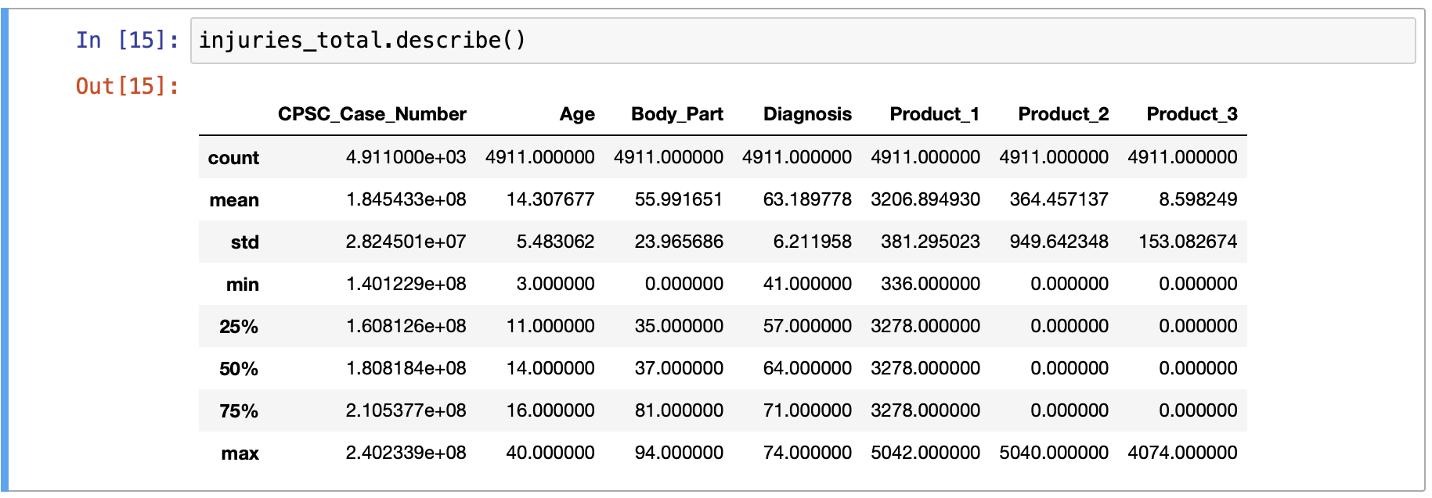
EDA
Mean age of the patients is about 14 years old
There are no missing values
The rest of the data represents textual data, so those calculations are not as representative
Notes:
c

Slide 10
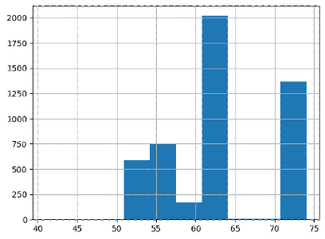
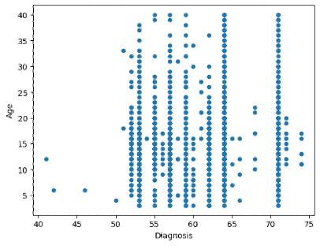
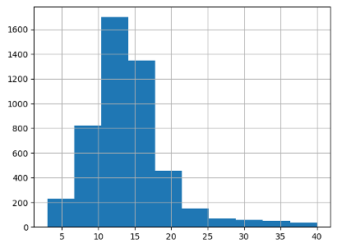
EDA
Diagnosis vs Frequency
Diagnosis vs Age
Age vs Frequency
Notes:
c

Slide 11
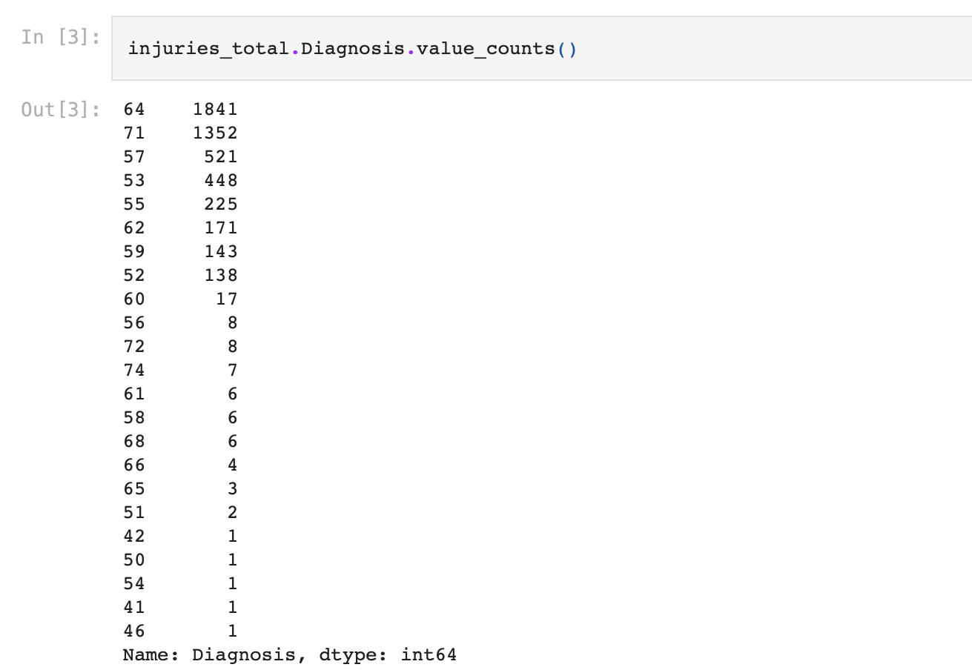
Model- Specific EDA
64 = sprain/strain
71 = other
57 = fracture
53 = contusions/ abrasions
55 = dislocation
62 = internal injury
Notes:
we conducted model-specific EDA. This step allowed us to visualize and interpret key patterns in the data, helping us determine the most appropriate modeling approach. We began by calculating the frequency of each injury type to understand their prevalence. Each injury type was assigned a unique numerical code. So we have, sprains and strains, the most common injury type represented by 64 with 1,841 occurences, ; ‘other’ injuries by 71; and fractures by 57 with 521 occurences.

Slide 12
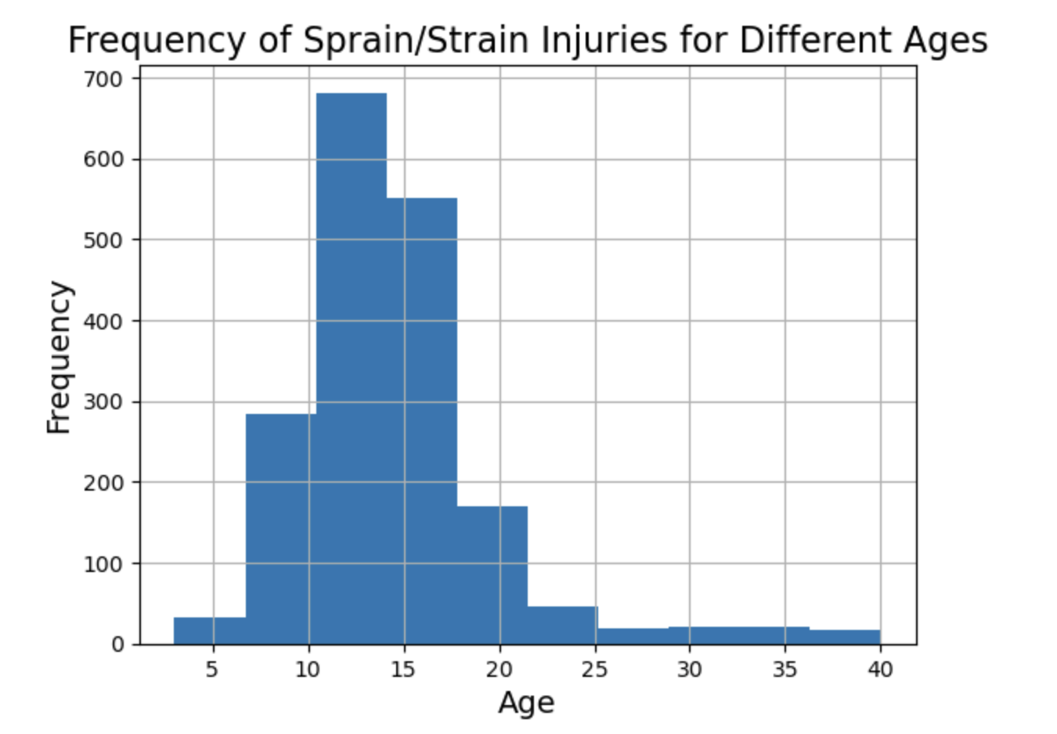
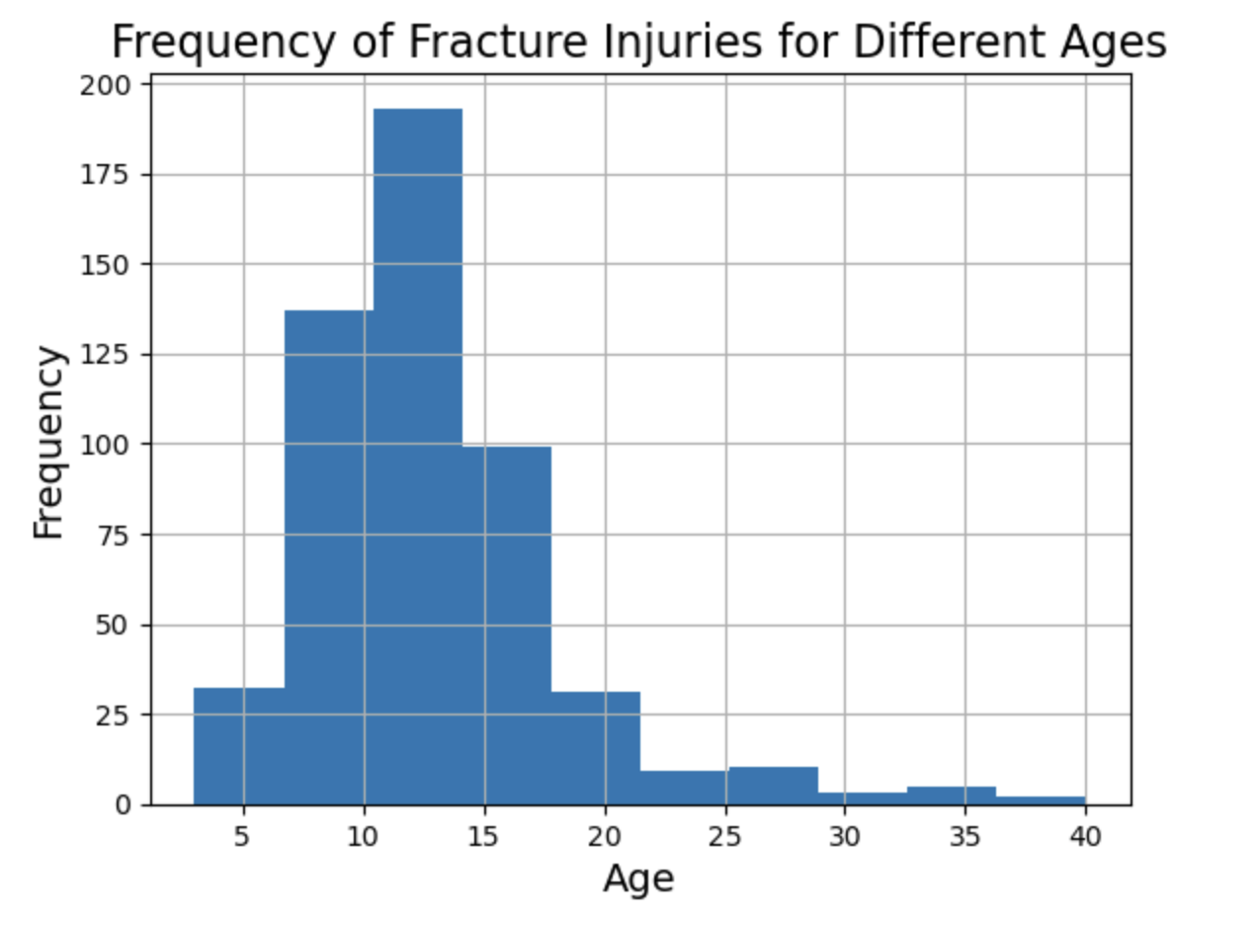
Model- Specific EDA
Notes:
Building on this analysis, we created histograms to visualize the distribution of our top two injury types. The first histogram displays age on the x-axis and the frequency of sprain or strain injuries on the y-axis. It reveals a clear peak in injury occurrence between the ages of 10 and 15. Similarly, the second histogram plots age on the x-axis and the frequency of fractures on the y-axis, showing a comparable peak within the same age range of 10 to 15 years. These findings highlight a critical period of vulnerability for young dancers.

Slide 13
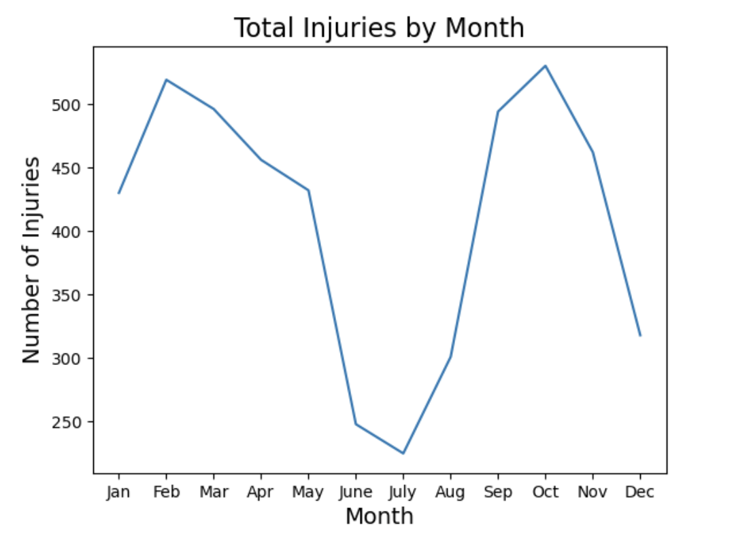
Notes:
Next, we examined whether the time of year influences injury rates. To do this, we created a graph with treatment month on the x-axis and total injury frequency on the y-axis. The results showed that injuries peak in February and October, with significant decreases in June, July, August, and December. We speculate that the lower injury rates in the summer months may be due to warmer weather, which could help dancers warm up more effectively. In December, the decrease could be attributed to the holiday season, when many dancers take time off.

Slide 14

LDA
What can we gather from this?
Fell, neck , shoulder, back
Twisted, ankle
Fell, elbow, foot
Hit, hip, head, chest
Pop, knee
Notes:
Next, we implemented an LDA text analysis model, which identifies the most important words in our dataset and organizes them into distinct topics. Each row of data included descriptive text about the type of injury the dancer experienced, and the model helped us uncover patterns in the language used.
The key topics identified were:
Topic 1: Fell, neck, shoulder, back
Topic 2: Twisted, ankle
Topic 3: Fell, elbow, foot
Topic 4: Hit, hip, head, chest
Topic 5: Pop, knee
These topics provide valuable insights into common mechanisms of injury. For example, topics involving 'fell' suggest that loss of balance may frequently lead to injuries involving the neck, shoulder, back, or elbow. Similarly, the prominence of words like 'twisted' and 'pop' indicates frequent ankle sprains and knee injuries, respectively.
This analysis allows us to better understand how dancers are getting injured, which can inform more targeted injury prevention strategies and interventions.

Slide 15
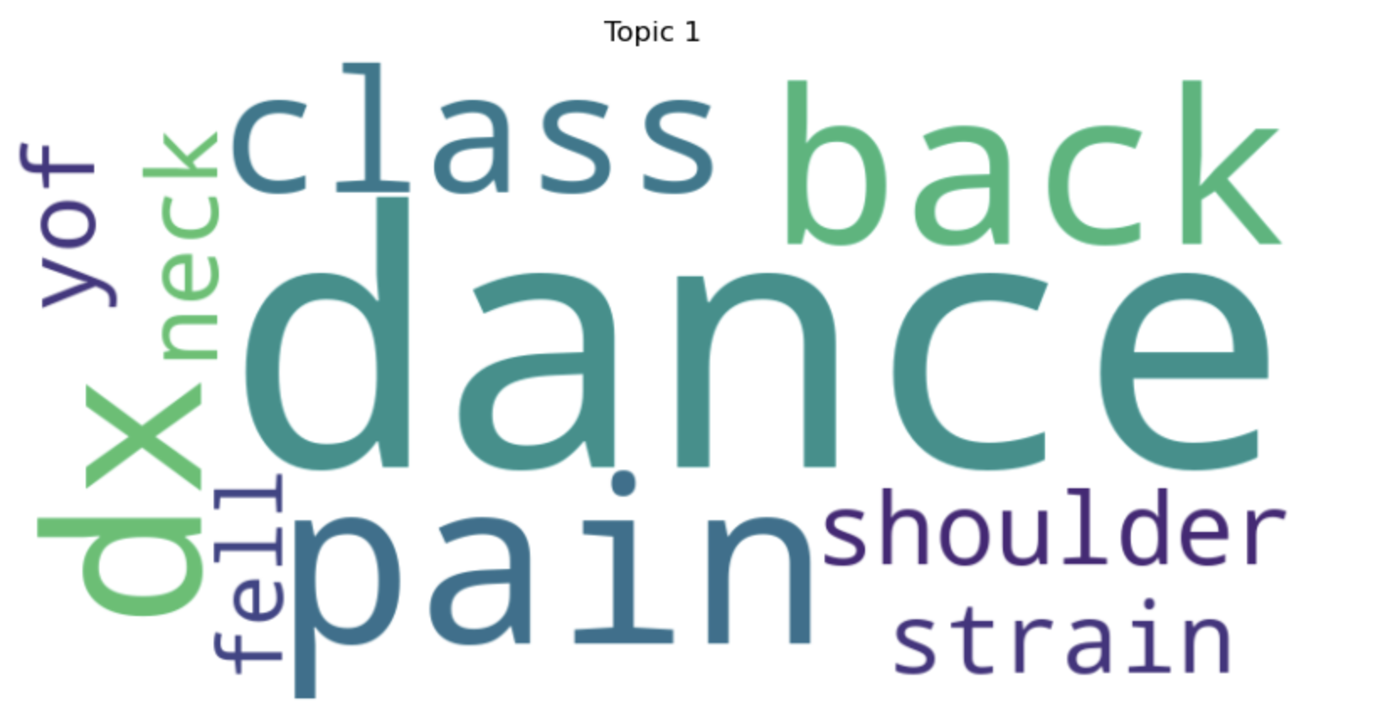
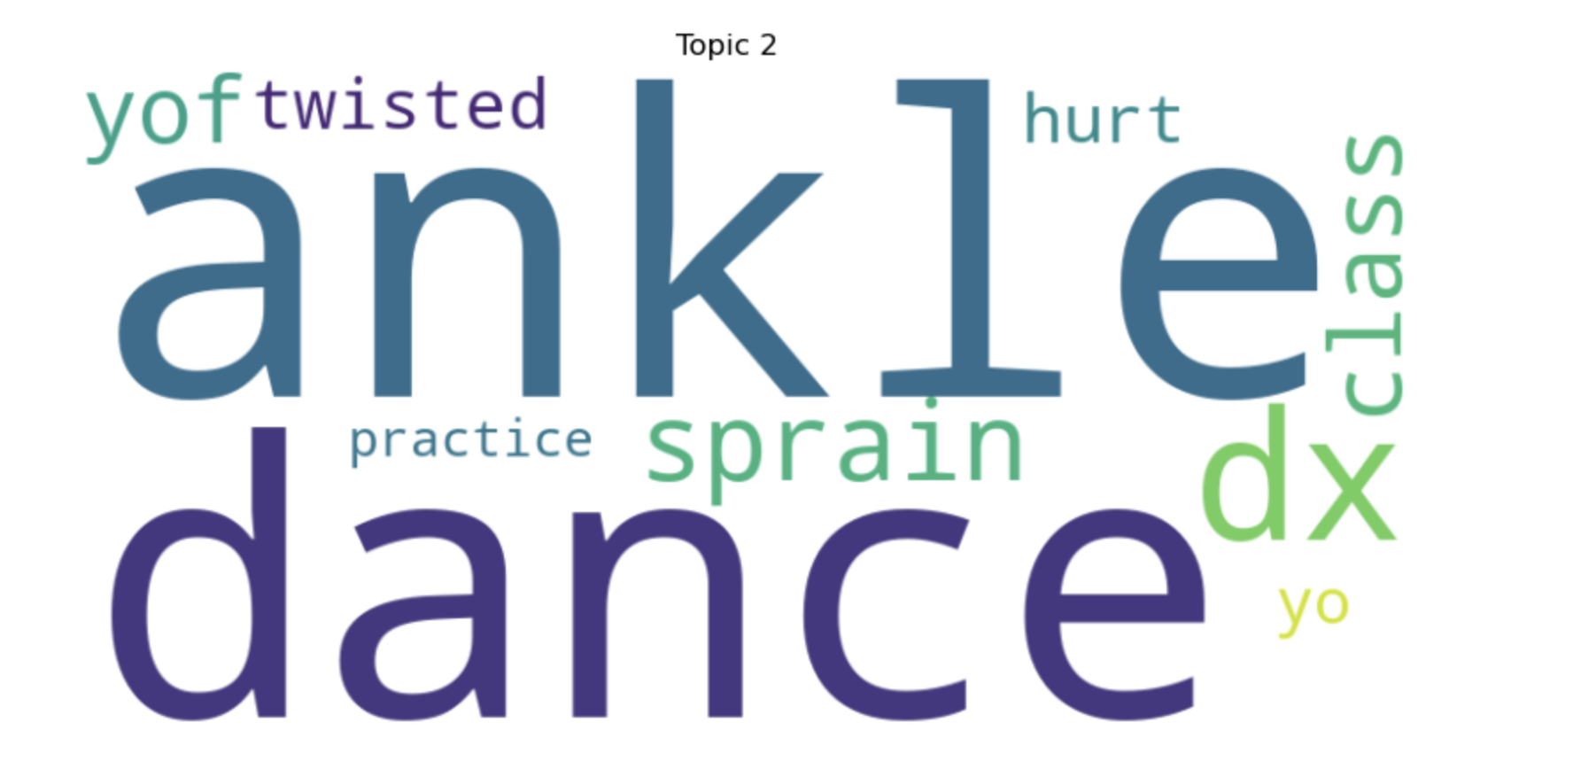
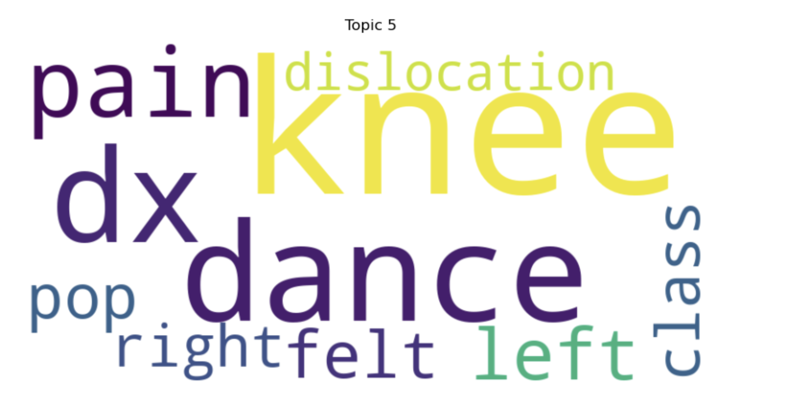
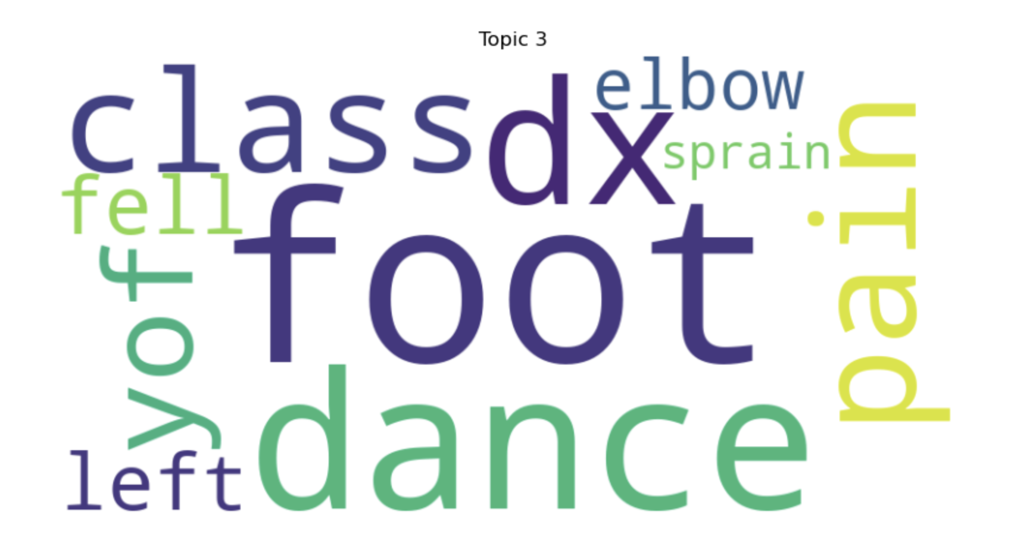
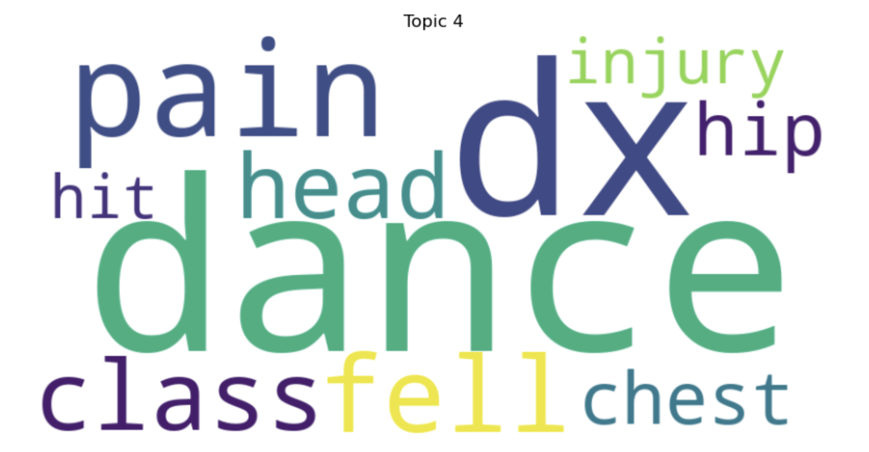

Slide 16
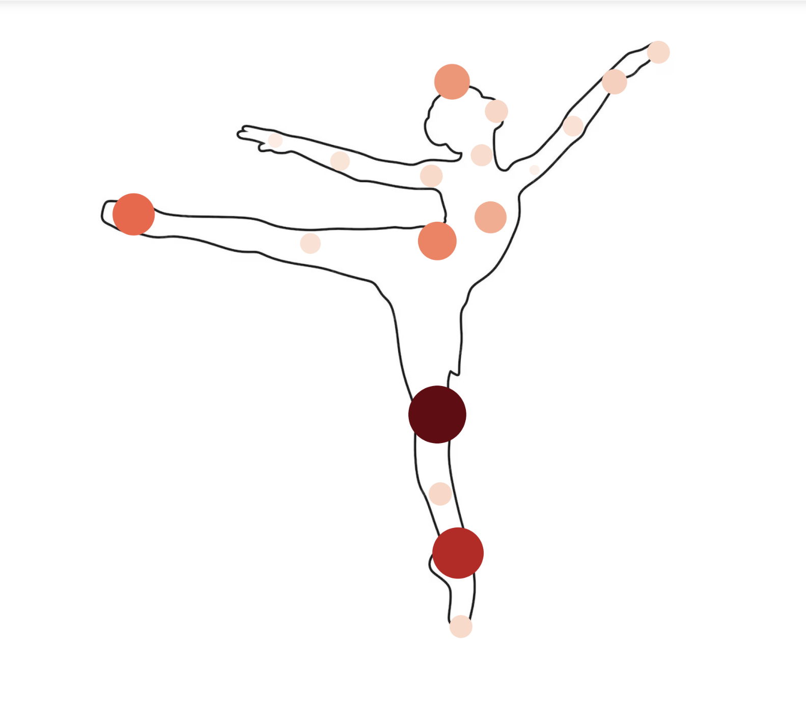
Where Are Dancers Being Injured?
Notes:
Next, we created a visual representation of a dancer's body to highlight where the most common injuries occur. This graphic uses dots to indicate injury locations, with the largest and darkest dots marking the areas most frequently affected. The results show that injuries are most common in the knee, ankle, foot, lower lumbar, and head. This visualization provides a clear and intuitive way to understand the physical areas most vulnerable to injury, reinforcing the importance of targeted prevention efforts for these high-risk zones.

Slide 17
Models
Decision tree and SVM models using age, body part, treatment month, and treatment year to predict sprain/strain and fracture injuries.
In order to properly run these models, we also transformed the Diagnosis column into a binary format
We also split the treatment dates into months and years.

Slide 18
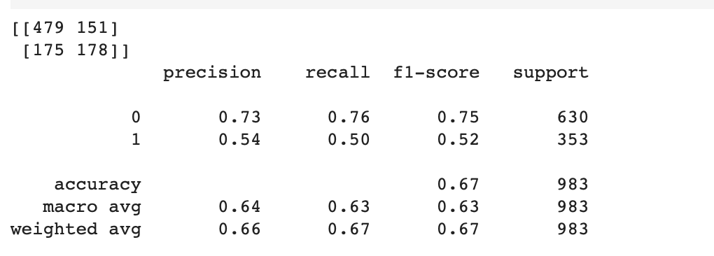
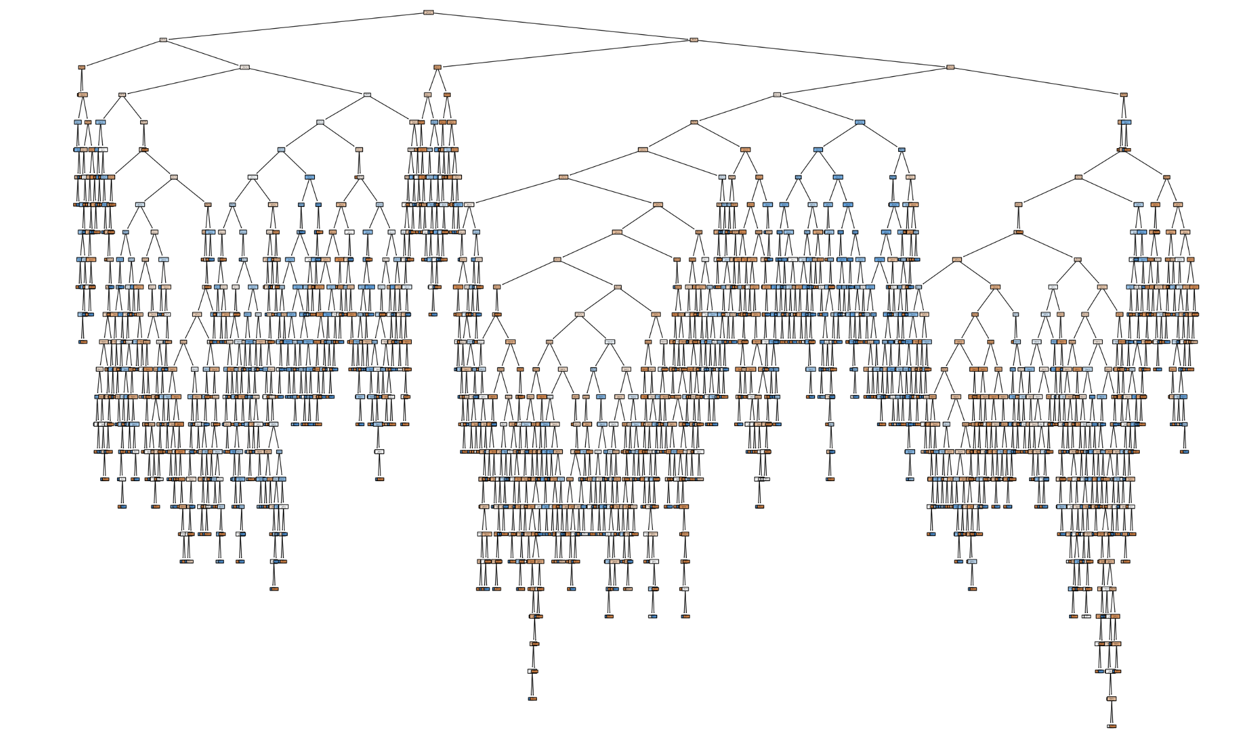
Decision Tree (Strain/Sprain)
Notes:
Our decision tree model, which uses age, body part, treatment month, and treatment date to predict sprain/strain injuries, achieved an overall accuracy of 67%. The model performs better at predicting non-sprain/strain injuries, with a precision of 73%, recall of 76%, and an F1-score of 0.75 for this class. However, its performance is lower for predicting sprain/strain injuries, with a precision of 54%, recall of 50%, and an F1-score of 0.52. Under our results we have one node of our decision tree visualized.

Slide 19
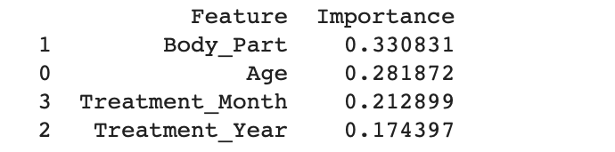
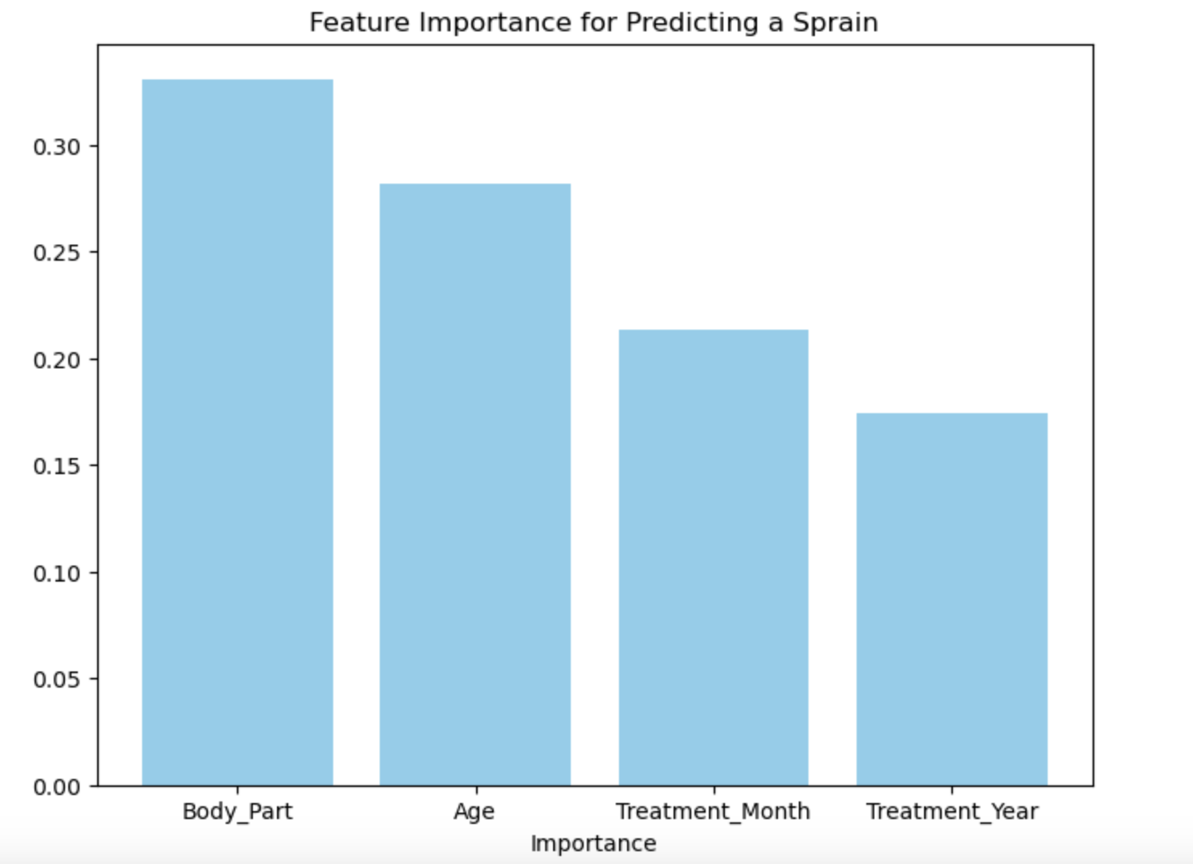
Feature Importances (Sprain/Strain)
Notes:
Here, we have graphed the feature importances from our decision tree model. First, we have Body Part, meaning it is the most significant feature in predicting sprain and strain outcomes. This suggests that the location on the body has the most influence on determining a sprain or strain injury. Next, we see Age ranked as the second most important feature. This means that the dancer’s age is a key factor in predicting sprain or strain injuries, as younger dancers may be more prone to injury as they have less knowledge or education. Third, we have Treatment Month, which could suggest seasonal trends in injury occurrences, such as certain times of the year being more prone to injuries due to factors like competition schedules or weather conditions. Lastly, we have treatment year, showing it has the least impact on injury prediction.

Slide 20
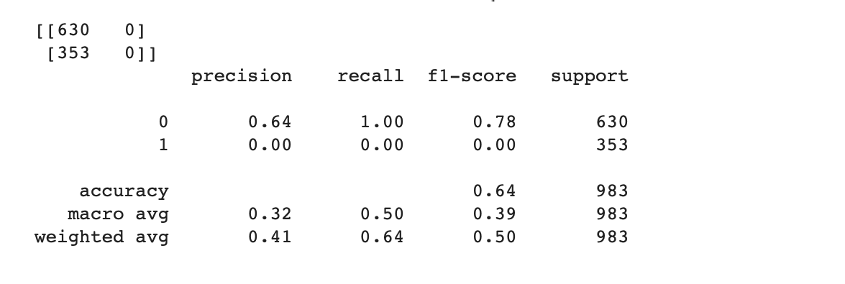
SVM (Strain/Sprain)
Notes:
Next, Our SVM model, which also uses age, body part, treatment month, and treatment date to predict sprain/strain injuries, achieved an overall accuracy of 64%. The model performs better at predicting non-sprain/strain injuries, with a precision of 64%, recall of 100%, and an F1-score of 0.78 .

Slide 21
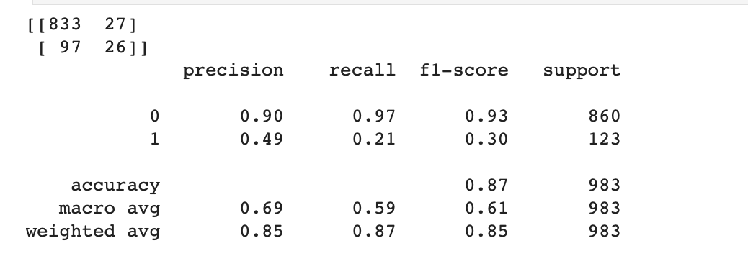
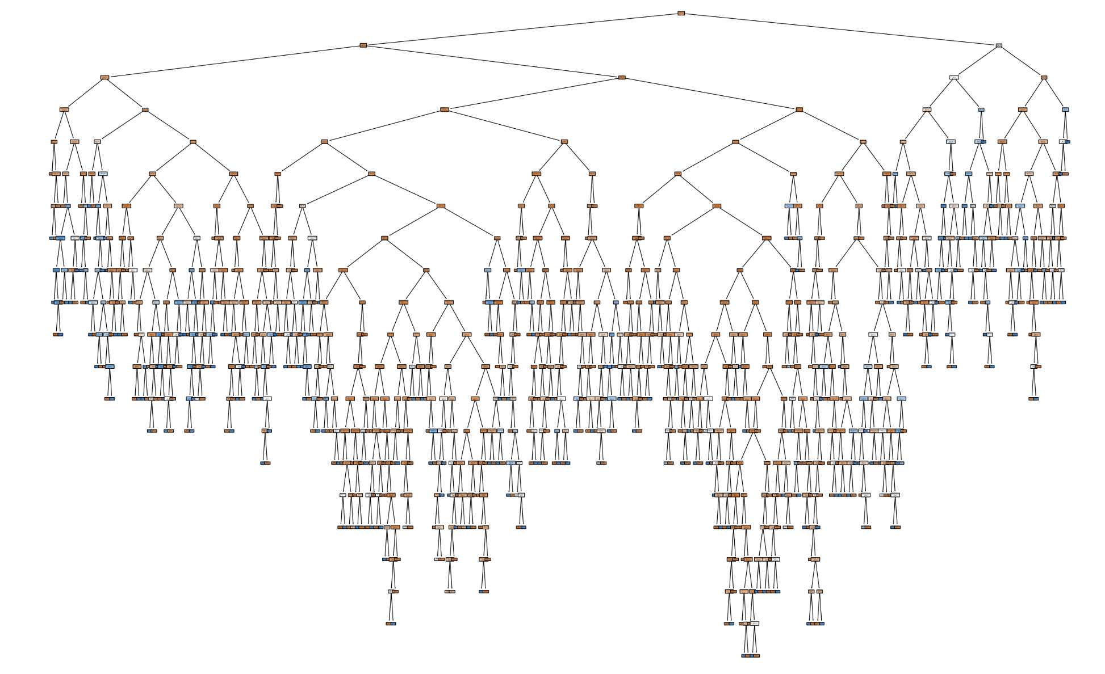
Decision Tree (Fracture)

Slide 22
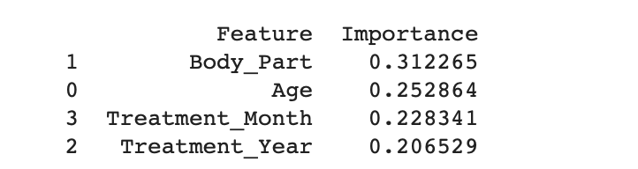
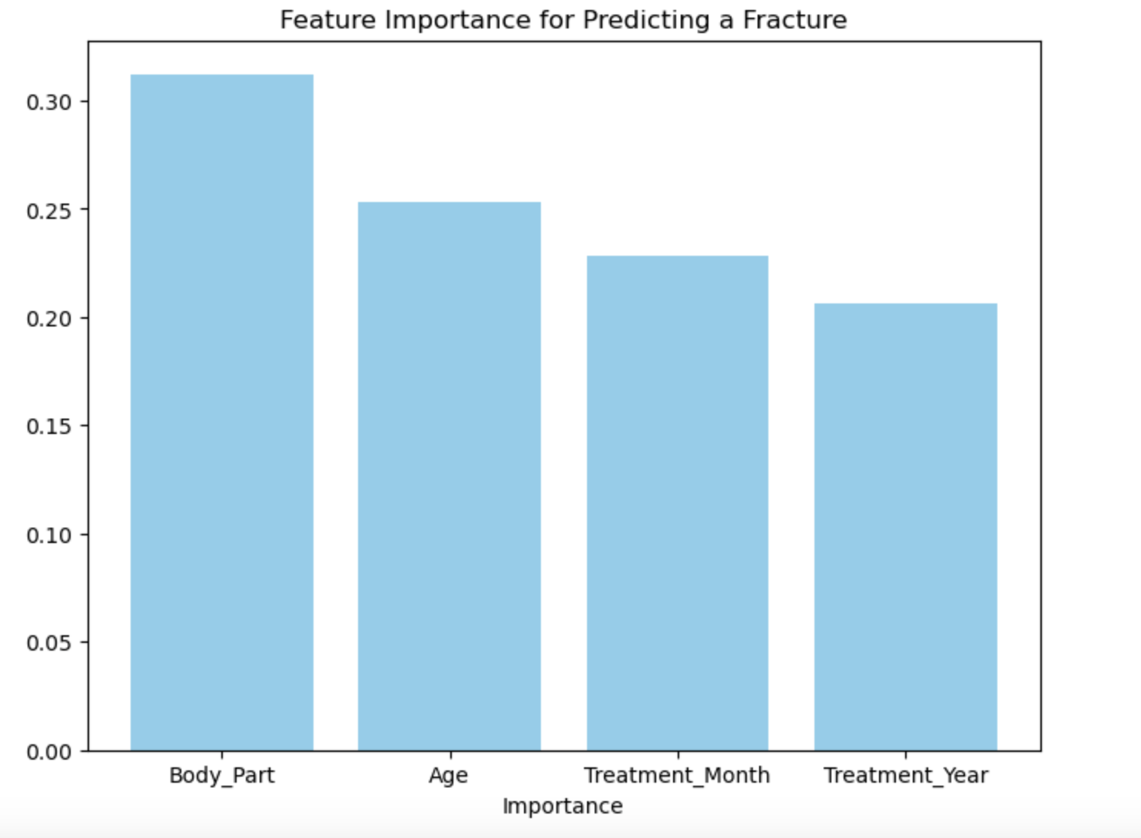
Feature Importances

Slide 23
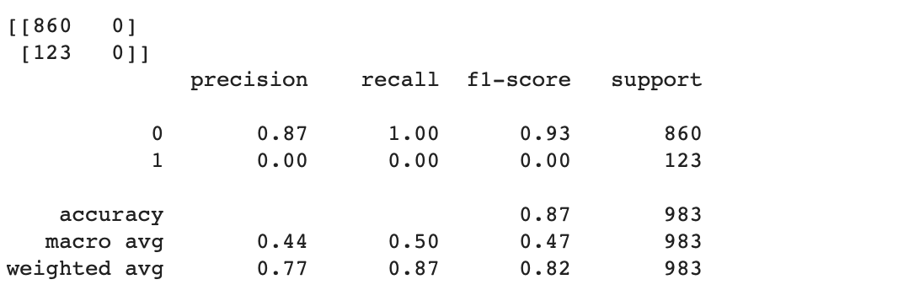
SVM (Fracture)

Slide 24
Conclusions
At what age are dancers most vulnerable to injury? | 10-15, peaking at age 14
When should injury prevention begin for dancers? | Early, before age 10.
Can we use age to predict sprain and/or fracture injuries? | Yes, age is a predictor for these common injury types.
What is the most common ways dancers are being injured? | Sprains, strains, fractures, falling, twisting, popping.
Notes:
Through our results, we uncovered several important findings related to injury patterns in dancers. At what age are dancers most vulnerable to injury? We found that dancers are most likely to get injured between the ages of 10 and 15, with the highest incidence of injuries occurring at age 14. This age group is particularly vulnerable to serious injuries such as sprains, strains, and fractures, suggesting that these types of injuries are common among young dancers.
When should injury prevention education begin for dancers? Injury prevention education should begin early, ideally before the age of 10, as this is when injury rates start to increase. The earlier dancers are educated about the body parts most prone to injury, the types of injuries that can occur, and how seasonal patterns may influence their risk, the more likely they are to make informed decisions about their training and warm-ups. Knowledge at this early stage is crucial for preventing long-term injury.
Can we use age to predict sprain and fracture injuries? Yes, our models confirm that age is a predictor of sprains, strains, and fractures—the most common injuries in dancers. However, while age is important, body part was found to be the most critical factor in predicting these injuries, highlighting the need for focused education on the specific body parts most vulnerable to injury, such as the knee, ankle, and foot.
What are the most common ways dancers are injured? The most common injuries are sprains, strains, and fractures, particularly in the knee, ankle, and foot. Our LDA analysis identified key terms like “fell,” “pop,” and “twisted,” which are commonly associated with these injuries, offering valuable insights into the mechanisms of injury. This reinforces the need for education targeting both injury prevention techniques and awareness of the ways in which injuries typically occur.
In conclusion, our findings emphasize the importance of early education and prevention strategies. By focusing on the age groups most vulnerable to injury and the body parts most at risk, we can better equip dancers with the knowledge they need to reduce their injury risk and make smarter, safer choices in their training.

Slide 25
Implications for Stake Holders
Dance Companies
Early career-ending injuries or improper injury care reduce the number of dancers available for long-term employment, increasing the liability and costs for dance companies.
Dance Teams
Injuries among team members can hinder performance and impact competition results, which are a key revenue source for dance studios.

Slide 26
Ethical Implications
Use of Medical Data
This is medical data, although there are no identifying pieces of data, people may not like their data being put out in a public way like this.
Culture Shift
The "dance through the pain" mentality is common in studios. If age is linked to injury prevention education, this could help shift to healthier practices
Access
If a correlation is found, would all dance studios have access to the necessary educational resources to implement these changes?

Slide 27
Thank you!
https://github.com/ccgurek/Data-400-Final-Project

